Slide 1
Economics 144 Economic Forecasting
Lecture 7
Characterizing Cycles
Moving Average Models
Dr. Randall R. Rojas

Slide 2
Today’s Class
Covariance Stationary Time Series
White Noise
The Lag Operator
Wold’s Theorem
Characteristics of the MA(q) Process
Example: MA(1) Process

Slide 3
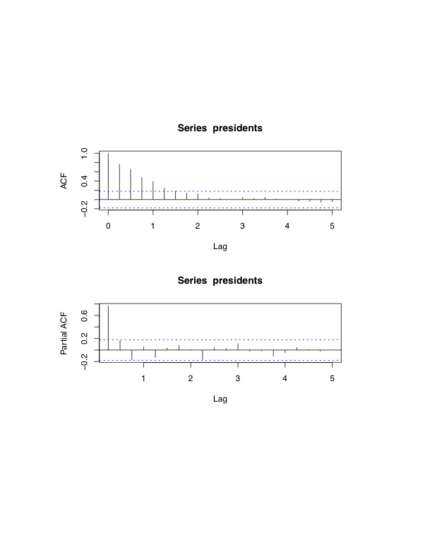
Covariance Stationary Time Series
Data
In R: acf(data)
Data
In R: pacf(data)
Recall that covariance stationary processes have ρ(k) and p(k) that →0 as k →inf.
Notes:
Sometimes the decay is faster, and at other times it is slower. But nonetheless, the decay indicates that the only the first few lags are significant

Slide 4
White Noise 1 of 3
White Noise: Time series process with zero mean, constant variance, and no serial correlation.
Since ρ(k) = 0 and p(k) = 0 for k ≥ 1, there is no link between past and present observations.
→ Cannot predict the future.
Examples: S&P500 returns, interest rates, etc.

Slide 5
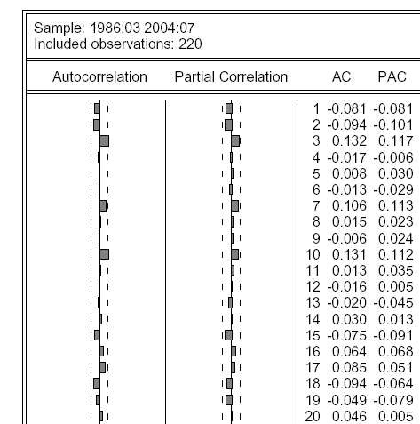
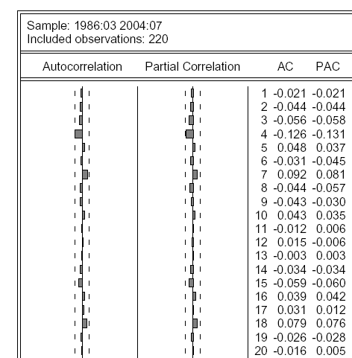
Example: Autocorrelation Functions of Monthly Returns for Microsoft and the Dow Jones Index
Notes:
Features of the graphs: mean reversion, clustering volatility. Since the acf and pacf have such low spikes, it is basically white noise

Slide 6
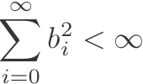

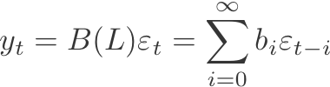
Wold’s Theorem (Part I)
Q: What’s left after filtering the trend and seasonal components?
A: Covariance stationary (short memory) residuals! How should we model them?→ Wold’s Theorem!
Wold’s Representation Theorem: Let {y_{t} } be any zero-mean covariance-stationary process. Then
and
where and b_{o}=1.
(Innovations)
Notes:
Covariance stationary have a special property which that it is short term.
The number of parameters might be too large to support data with smaller number of observations

Slide 7

Moving Average Models
Def: MA(q) = Moving Average process or order q≥0: Y_{t} = μ +θ₁ ε_{t-1} + θ₂ ε_{t-2} + …+θ_{q} ε_{t-q}, where
Examples:
MA(1): Y_{t} = μ +θ₁ ε_{t-1} + ε_{t}
MA(5): Y_{t} = μ +θ₁ ε_{t-1} + θ₅ε_{t-5}+ ε_{t}
MA(10): Y_{t} = μ +θ₁₀ε_{t-10}+ ε_{t}
Notes:
Miu

Slide 8
Moving Average Models
For every MA(q) process, we need to address the following 3 questions:
What does a time series of an MA process look like?
What do the corresponding ACFs and PACFs look like?
What is the optimal forecast?

Slide 9
Moving Average Models Example: MA(1) Process
(1) What does a time series of an MA process look like?
Consider the following MA(1) process:
Y_{t} = μ +θ ε_{t-1} + ε_{t}
We can plot this process for μ =2, and different values of θ, e.g., for θ=0.05, θ=0.5, θ=0.95, and θ=2.
We can show that E(Y_{t})=0, and σ²(Y_{t}) = (1+θ²)σ²_{ε}

Slide 10
MA(1): Y_{t} = μ +θ ε_{t-1} + ε_{t}
θ=0.05
θ=0.5
θ=0.95
θ=2
Notes:
The amplitude increases as the theta increases. The volatility stays constant
Since this is a covariance stationary, the numbers go down immediately after it goes up

Slide 11
Moving Average Models Example: MA(1) Process
(2) What do the corresponding ACFs and PACFs look like?
ACF:
(i) We would expect to see only 1 spike different from zero, i.e., ρ₁≠0, and all others equal to zero (ρ_{k}=0, k>1).
(ii) The magnitude of the spike should be proportional to θ for |θ|<1.
Note: You can show (please fill in t he steps) that
ρ₁ = θ /(1+θ²)
(iii) Given the expression above, the sign of the ACF is the same as the sign of θ.

Slide 12
Moving Average Models Example: MA(1) Process
(2) What do the corresponding ACFs and PACFs look like?
PACF:
Note: You can show (please fill in the steps) that the autocovariance of order 1 is given by: γ₁ = θσ²_{ε} , and all other orders are equal to 0.
(i) The PACF decreases to zero in an alternating fashion, according to p_{k} >0 (k=odd), and p_{k}<0 (k =even).
(ii) We can also show that p₁ = ρ₁.

Slide 13
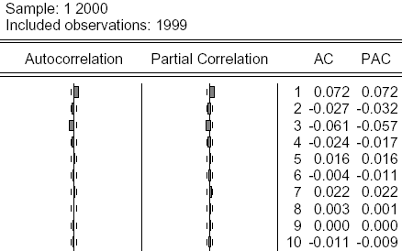
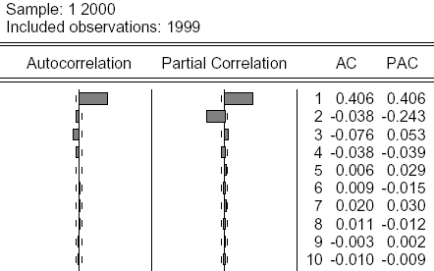
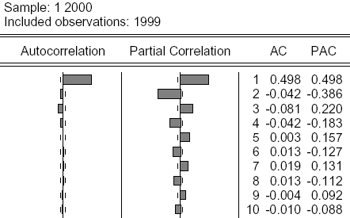
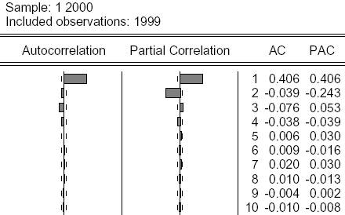
Autocorrelation Functions of Simulated MA(1) Processes
Can you distinguish them?
Notes:
The higher the value of theta, the higher the magnitude of the PACF, but abs(theta)<1

Slide 14
Moving Average Models Example: MA(1) Process
From our previous example, based on the ACFs alone, we could not distinguish the MA(1) process with θ=0.5 from the MA(1) process with θ=2. This property is known as invertibility.
Def: Invertibility
An MA(1) process is invertible if |θ| <1. Otherwise, if |θ|≥1, the process is noninvertible.

Slide 15

Moving Average Models Example: MA(1) Process
Meaning of Invertibility: You can transform the MA(1) process to an ‘autoregressive’ function of its own past (lagged values), such that the recent past has more weight than the distant past.
Example: Y_{t} = μ +θε_{t-1} + ε_{t} = μ + (1-(-θ)L) ε_{t}
Solve for ε_{t} →
Notes:
The 1/denominator can be represented with a Taylor expansion

Slide 16

Moving Average Models Example: MA(1) Process
Since |θ|<1, we can perform a Taylor series expansion of the denominator:
Therefore, we can re-express
as:
→
= Autoregressive Process
Notes:
The higher values of the power of theta, the smaller the theta to that power since theta is smaller than 1, which means that the higher order or Y-u is negligient

Slide 17

Moving Average Models Example: MA(1) Process
If an MA process is invertible, you can always find an Autoregressive representation.
To predict the future, we need the information contained in the past.
As noted earlier, the recent past has more weight than the distant past since:

Slide 18
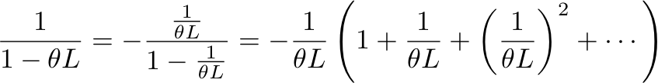
Moving Average Models Example: MA(1) Process
Q: What can we conclude for the case when |θ|≥1?
A: We cannot perform the Taylor series expansion on θ but we can on 1/θ.
Since θ>1, consider expanding 1/(1-θL) as follows:
Infinite lag polynomial

Slide 19



Moving Average Models Example: MA(1) Process
Def: Forward Operator (F) = 1/L, where
FY_{t} = Y_{t+1} → F(L(Y_{t} )) = F(Y_{t-1}) = Y_{t}. The forward operator is inverse of the lag operator. It delivers the process at a future date.
The present is a
function of the future.
Autoregressive representation of a noninvertible MA(1) process.

Slide 20
Moving Average Models Example: MA(1) Process
If an MA process is invertible, you can always find an Autoregressive representation.
To predict the future, we need the information contained in the past.
As noted earlier, the recent past has more weight than the distant past since:

Slide 21
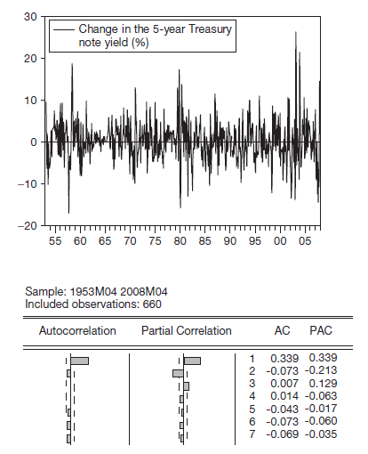

Moving Average Models Example: MA(1) Process
What is the practical use of all this?
What process would you suggest?
→ MA(1)

Slide 22
Moving Average Models Forecasting in an MA(1) Process
Consider first the 1-step-ahead forecast, h = 1:
MA(1): Y_{t} = μ +θε_{t-1} + ε_{t} →Y_{t+1} = μ +θε_{t} + ε_{t+1}
Optimal Point Forecast: f_{t,1} = E(Y_{t+1}|I_{t}) = μ +θε_{t}
Note: We can write ε_{t} in terms of lags of Y_{t}
One-period-ahead Forecast Error: e_{t,1} = Y_{t+1} - f_{t,1}= ε_{t+1}
Uncertainty of the Forecast: σ²_{t+1|t} = var(Y_{t+1}|I_{t}) = σ²_{ε}
Density Forecast: f(Y_{t+1}|I_{t}) ~ N(μ +θε_{t} , σ²_{ε} )
Note: We can compute the confidence intervals from the density forecast.
Please go over the steps for h=1 and h=2 (Section 6.2ª)

Slide 23
Moving Average Models Forecasting in an MA(1) Process
Consider first the k-step-ahead forecast, h = k:
MA(1): Y_{t} = μ +θε_{t-1} + ε_{t} →Y_{t+1} = μ +θε_{t} + ε_{t+1}
Optimal Point Forecast: f_{t,k} = E(Y_{t+k}|I_{t}) = μ
k-period-ahead Forecast Error: e_{t,k} = Y_{t+k} – f_{t,k}= ε_{t+k}+θε_{t+k-1}
Uncertainty of the Forecast: σ²_{t+k|t} = σ²_{ε}(1+θ²) = σ²_{Y}
Density Forecast: f(Y_{t+k}|I_{t}) ~ N(μ, σ²_{Y} )

Slide 24


Moving Average Models Example: MA(1) Process
Forecasting the 5-year Constant Maturity Yield
Model: Y_{t} = μ +θε_{t-1} + ε_{t}
Estimated Model: Y_{t} = 0.160 +0.485ε_{t} + ε_{t}
where and

Slide 25
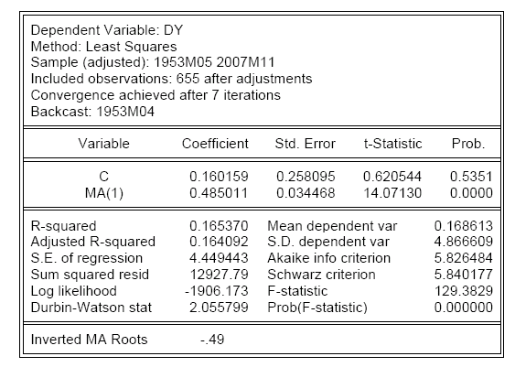
Estimation Output: 5-Year Treasury Yield (Monthly Percentage Changes)

Slide 26
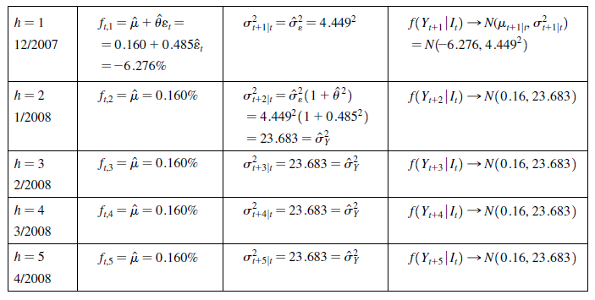
December 2007-April 2008 Forecasts of 5-year Treasure Yield Changes

Slide 27
Moving Average Models Example: MA(1) Process

Slide 28
Moving Average Models Example: MA(2) Process
(a)
(b)
Notes:
Left has more persistence, greater volatility

Slide 29
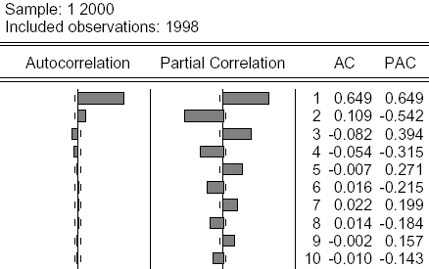
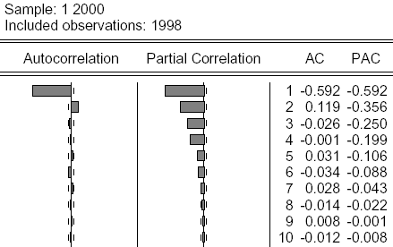
Both ACFs show
2 spikes only
→ MA(2)
Notes:
The PACF inverts since we negate the epsilon for t-1

Slide 30
Moving Average Models Example: MA(?) Process

Slide 31
Moving Average Models Example: MA(?) Process
Daily Returns to Microsoft
3-day MA is less volatile
Notes:
Since we are taking a 3-day moving average, the averaging makes the curve smoother

Slide 32
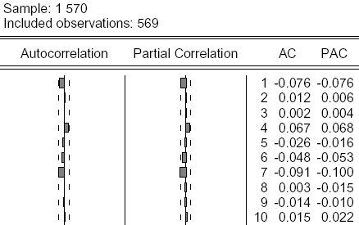
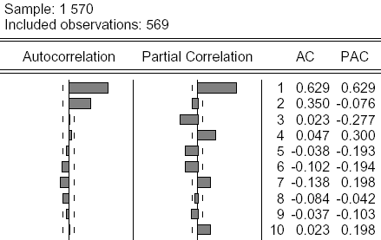
Moving Average Models Example: MA(2) Process
Returns
3-day MA
Looks like white-noise
Looks like an MA(2) process
Notes:
For 3-day MA, it looks like an MA(2) process
For any covariance stationary process, you could do an MA average, then you could get an ACF and PACF resembles on of another MA process to model the day

Slide 33
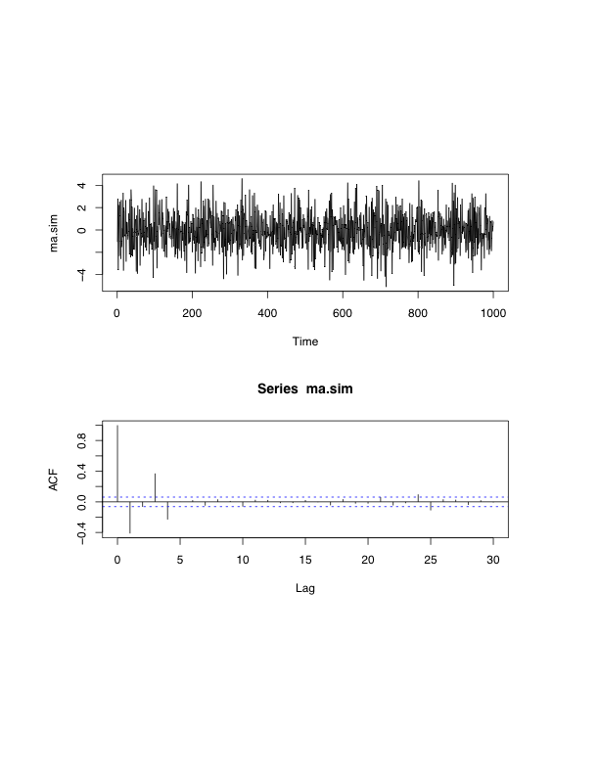
Moving Average Models Example: MA(q) Process
What type of a
process is this?
MA(4) Process
In general, for any MA(q) process, ρ_{k} = 0 for any k>q.

Slide 34
For Next Class
Readings about today’s class:
Chapter 6ª, 8^{b}
Review Exercises / Problems:
Chapter 7^{b}: 1, 2, 3
Readings for next class:
6ª ,7ª, 8^{b}, 9^{b}

